Slide 1
School of Computing Science and Engineering
Course Code: BCSE2350 Course Name: Cryptographic Fundamental
Mathematics of Cryptography

Slide 2
Contents
Introduction
Primes
Euler’s Phi-Function
Fermat’s Little Theorem
Euler’s Theorem

Slide 3
Introduction
This chapter reviews some mathematical background concept needed for understanding the asymmetric-key or publickey cryptography.
The primes is one of the mathematical concept uses in this cryptography extensively.

Slide 4
Two theorems that play important roles in asymmetric-key cryptography are Fermat’s and Euler’s theorem.
An important requirement in a number of cryptography algorithms is the ability to choose a large prime number.
Discrete logarithms are fundamental to a number of asymmetric-key algorithms, but it operates over modular arithmetic.

Slide 5
Prime
The topic is a large part of any book on number theory
Positive integers can be divided into three groups.

Slide 6
A positive integer is a prime if and only if it is exactly divisible by two integers: 1 and itself.
A composite is a positive integer with more than two divisors or it can be factored into two or more values other than one (1) and itself.

Slide 7
What is the smallest prime?
Solution:
Integer 2, which is divisible by 2 (itself) and 1.
Note - Integer 1 is not a prime because it cannot be divisible by two different integers but only by itself.

Slide 8
List the primes smallest than 10.
Solution:
There are four primes less than 10: 2, 3, 5, and 7.
It is interesting to note that the percentage of primes in the range 1 to 10 is 40%.
The percentage decreases as the range increases.

Slide 9
Now, two questions naturally arise:
Is there a finite number of primes?
Is the list infinite?
Given a number n, how many primes are smaller than or equal to n?

Slide 10
Infinite Number of Primes
Here is an informal proof.
Suppose the set of primes is finite (limited), with p as the largest prime.
Multiply the set of primes become
The integer (P+1) cannot have a factor q ≤ p.
If q also divides (P+1), then q divides (P+1) – P = 1
The only number that divides 1 is 1, which is not a prime.
Therefore, q is larger than p.

Slide 11
Example
Assume that the only primes are in the set { 2, 3, 5, 7, 11, 13, 17 }.
If P = 510510, how many more primes are not in the set?
Solution:
P + 1 = 510511
However, 510511 = 19 × 97 × 277; none of these primes were in the original list.
Therefore, there are three primes greater than 17.

Slide 12
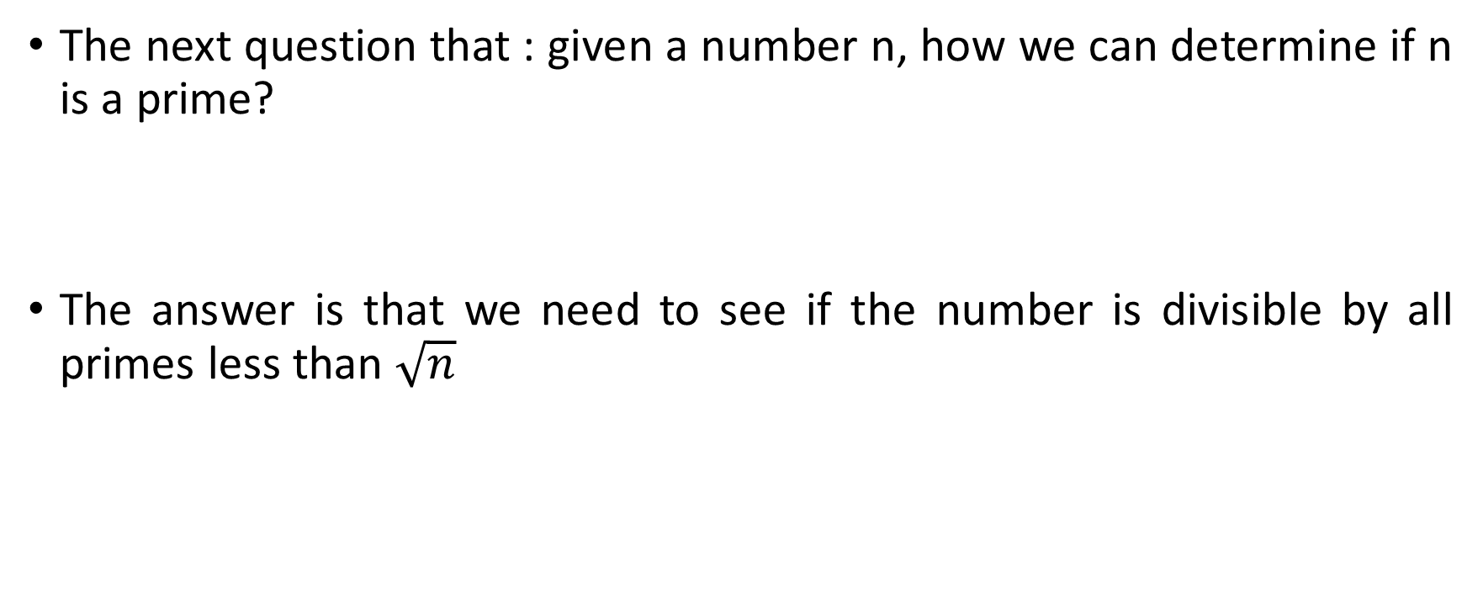
Checking for Primeness
The next question that : given a number n, how we can determine if n is a prime?
The answer is that we need to see if the number is divisible by all primes less than $\sqrt{n}$

Slide 13
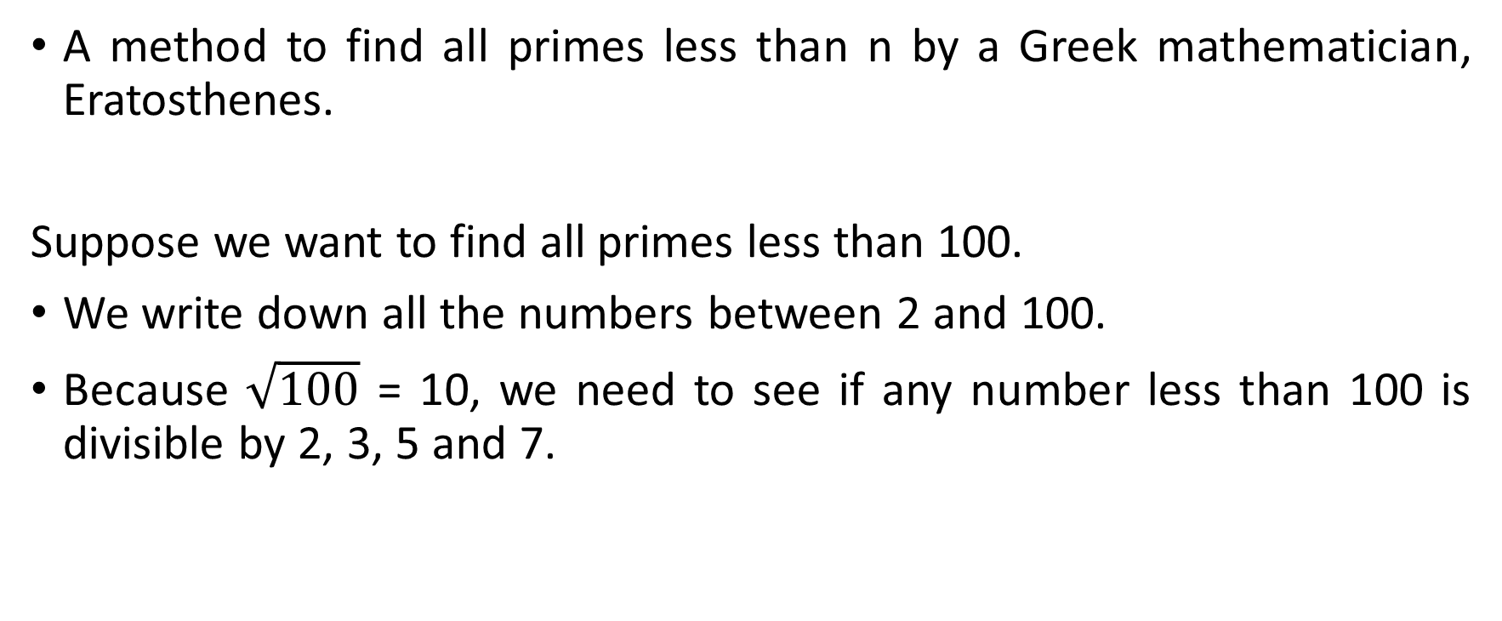
Sieve of Eratosthenes
A method to find all primes less than n by a Greek mathematician, Eratosthenes.
Suppose we want to find all primes less than 100.
We write down all the numbers between 2 and 100.
Because $\sqrt{100}$ = 10, we need to see if any number less than 100 is divisible by 2, 3, 5 and 7.

Slide 14
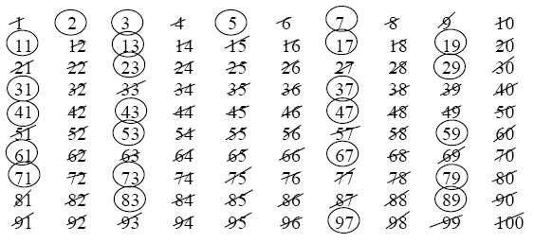

Slide 15
The following shows the process:
1. Cross out all numbers divisible by 2 (except 2 itself)
2. Cross out all numbers divisible by 3 (except 3 itself)
3. Cross out all numbers divisible by 5 (except 5 itself)
4. Cross out all numbers divisible by 7 (except 7 itself)
5. The numbers left over are primes.

Slide 16
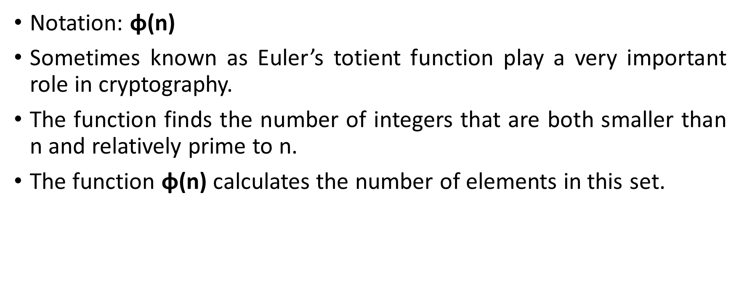
Euler’s Phi-Function
Notation: φ(n)
Sometimes known as Euler’s totient function play a very important role in cryptography.
The function finds the number of integers that are both smaller than n and relatively prime to n.
The function φ(n) calculates the number of elements in this set.

Slide 17
The following rules help to find the value of φ(n)
These four rules can be combined to find the value of φ(n)
φ(1) = 0
φ(p) = p-1 if p Is prime
φ(m x n) = φ(m) x φ(n) if m and n are relatively prime
φ(p^{e}) = ( p^{e} - p^{e-1} ) if p is prime
Example: if n can be factored as n = p₁^{e1} x p₂^{e2} x …. x p_{k}^{ek}
then we combine the third and fourth rules to find
φ(n) = ( p₁^{e1} - p₁^{e1-1} ) x ( p₂^{e2} - p₂^{e2-1} ) x ... x ( p_{k}^{ek} - p_{k}^{ek-1} )

Slide 18
1. What is the value of φ(13)?
(Second rule): Because 13 is a prime, φ(13) = (13-1) = 12
2. What is the value of φ(10)?
(Third rule): Because 2 and 5 are a primes.
φ(10) = φ(2) x φ(5)
= (2 -1) x (5 -1)
= 1 x 4 = 4
3. What is the value of φ(240)?
We can write 240 = 2⁴ x 3¹ x 5¹
Then, f (240) = (2⁴ - 2³ ) x (3¹ - 3⁰ ) x (5¹ - 5⁰ )
= (16 - 8) x (3 -1) x (5 -1)
= 8 x 2 x 4 = 64

Slide 19
Find the value of the following φ (n).
a) φ (29)
b) φ (32)
c) φ (80)
d) φ (100)
e) φ (101)

Slide 20
a) φ (29) = 28
b) φ (32) = 16
c) φ (80) = 32
d) φ (100) = 40
e) φ (101) = 100

Slide 21
Fermat’s Little Theorem
Plays a very important role in number theory and cryptography.
Sometime helpful for quickly finding a solution to some exponentiations.
Two version of the theorem:
a^{p} ≡ a mod p
Remove the condition on a.
If p is a prime and a is an integer.
a^{p-1} ≡ 1 mod p
If p is a prime and a is an integer such that p does not divide a.

Slide 22
Multiplicative Inverses
a⁻¹ mod p = a^{p-2} mod p
A very interesting application of Fermat’s theorem in finding some multiplicative inverses quickly if the modulus is a prime.
p is a prime and a is an integer.
The answers to multiplicative inverses modulo a prime can be found without using the extended Euclidean algorithm:

Slide 23
Find the result of the following, using Fermat’s little theorem:
a) 5¹⁵ mod 13
b) 5¹⁸ mod 17
c) 456¹⁷ mod 17
d) 145¹⁰² mod 101

Slide 24
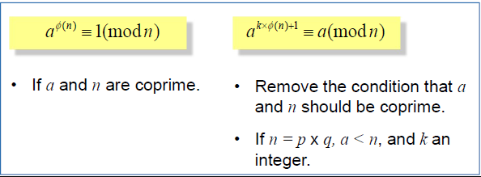
Euler’s Theorem
Can be thought of as a generalization of Fermat’s Little theorem.
The modulus in Fermat’s theorem is a prime, while Euler’s theorem is an integer.
Two version of this theorem:

Slide 25
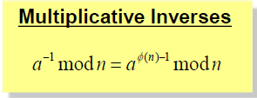
Euler’s theorem can be used to find multiplicative inverses modulo a prime or a composite.
n and a are coprime.
The answers to multiplicative inverses modulo a composite can be found without using the extended Euclidean algorithm if we know the factorization of the composite:

Slide 26
Find the result of the following, using Euler’s theorem:
a) 12⁻¹ mod 77
b) 16⁻¹ mod 323
c) 20⁻¹ mod 403
d) 44⁻¹ mod 667

